Slide 1
UNIT 3- PART II: ORM
PROGRAMMING WITH HIBERNATE

Slide 2
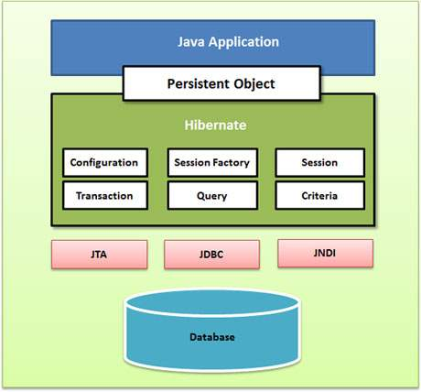
5. PROGRAMING WITH HIBERNATE
Hibernate APIs:

Slide 3
5.1.Configuration Object
The Configuration object is the first Hibernate object you create in any Hibernate application. It is usually created only once during application initialization. It represents a configuration or properties file required by the Hibernate.
It provides two keys components:
Database Connection − This is handled through files hibernate.properties and hibernate.cfg.xml.
Class Mapping Setup − This component creates the connection between the Java classes and database tables.

Slide 4
5.2. SessionFactory Object
Configuration object is used to create a SessionFactory object. SessionFactory configures Hibernate for the application using the supplied configuration file and allows for a Session object to be instantiated. The SessionFactory is a thread safe object and used by all the threads of an application.
The SessionFactory is a heavyweight object; it is usually created during application start up and kept for later use. You would need one SessionFactory object per database using a separate configuration file. So, if you are using multiple databases, then you would have to create multiple SessionFactory objects.
SessionFactory sf ;
sf=new Configuration().configure().buildSessionFactory();

Slide 5
5.3. Session Object
A Session is used to get a physical connection with a database. The Session object is lightweight and designed to be instantiated each time an interaction is needed with the database. Persistent objects are saved and retrieved through a Session object.
The session objects should not be kept open for a long time because they are not usually thread safe and they should be created and destroyed them as needed.
Session session=sf.openSession();
Transaction tx=session.beginTransaction();
session.save(p);

Slide 6
5.4. Transaction Object
A Transaction represents a unit of work with the database and most of the RDBMS supports transaction functionality. Transactions in Hibernate are handled by a transaction manager (from JDBC or JTA).
This is an optional object and Hibernate applications may choose not to use this interface, instead managing transactions in their own application code.
It is the object to save, delete and update objects in the database

Slide 7
https://www.tutorialspoint.com/hibernate/hibernate_examples.htm

Slide 8
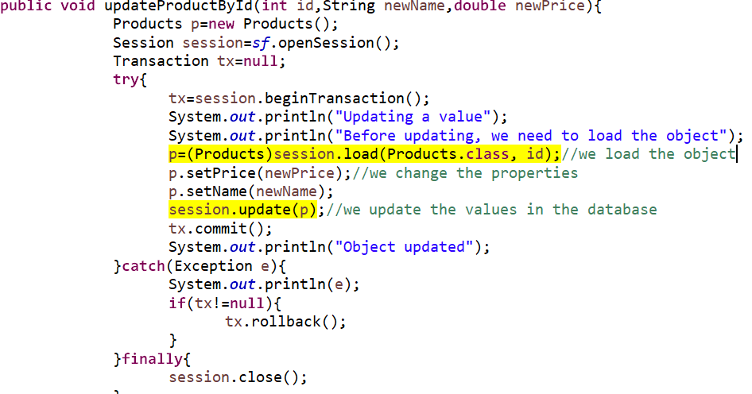
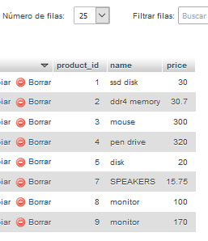

Practice 3.2. programming with hibernate

